Slide 1
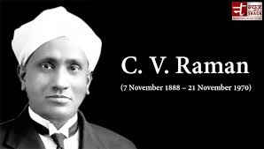
Dr. Chandrasekhara Venkata Raman.
an Indian physicist and Nobel laureate in 1930 in physics for his work on ‘the scattering of light’.
well-known for his work on the molecular scattering of light.
for the discovery of the Raman effect, which is named after him.
In 1934, the director of the newly established Indian Institute of Science in Bangalore.
In 1947, the first National professor by the new Government of independent India.

Slide 2
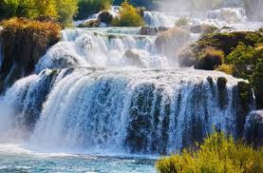
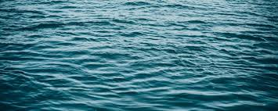
“Water-The Elixir of Life” by C.V. Raman

Slide 3
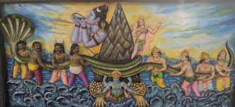
Samudra Manthan

Slide 4
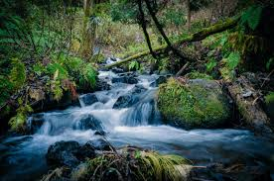
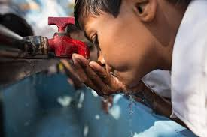
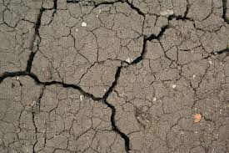
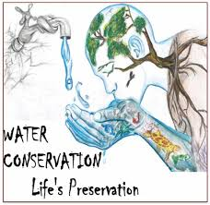
C.V.Raman in Water-the elixir of life
brings out how water is indispensable to plant
human life
and how it also causes evils like soil-erosion.
also tells excess of water can be preserved for good purposes.

Slide 5
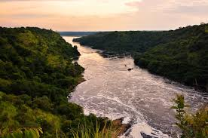
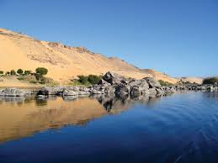
-gives the example of the Libyan Desert and the Valley of the Nile. Though both of them lie side by side, the first is a dry and arid desert while the latter is one of the most fertile valleys on this planet. The presence of the river Nile in the Valley of Nile is responsible for this huge difference between the two places. He in fact remarks that the entire civilization of Egypt was nurtured and sustained by the life-giving water of the Nile.

Slide 6
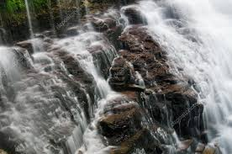
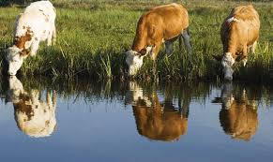
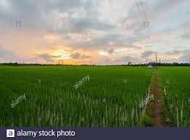
In the first part of the essay, Raman talks poetically of the beauty of water. Water trickling down the rocks or water collected in small ponds that satisfy the thirst of passing cattle are beautiful sights. Big tanks play a vital role in South Indian agriculture. Much of the rice is grown under them. It is a beautiful sight to watch the sun rise or set over them.

Slide 7
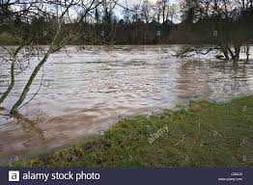
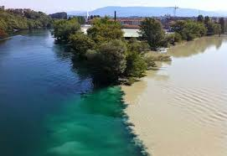
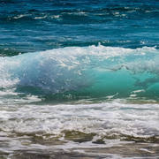
One of the most remarkable facts about water is that it carries silt to far-off places where it is finally deposited. The land where silt is deposited is usually very fertile. The silt that mixes with the salt water of the sea precipitates rapidly. The colour of the water changes successively from the muddy red or brown to yellow and green and finally to the blue of the deep sea. These varying shades are also fascinating.

Slide 8
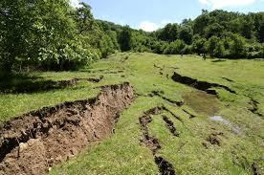
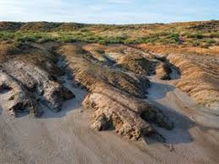
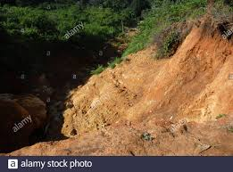
The flow of water has undoubtedly played a great part in geological processes. Rapidly flowing water carries away the rich top layer of the soil. This phenomenon is called soil erosion. The problem of soil erosion is of major significance in various countries especially in India. Soil erosion in the initial stage is unnoticed. Later, it results in the formation of deep gullies, ravines and ruts. These things affect agriculture.

Slide 9
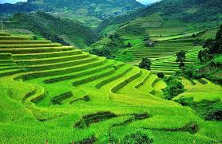
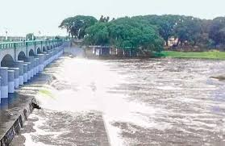
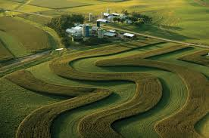
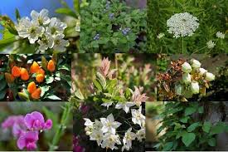
The terracing of the land,
the construction of bandhs (dams) to check the flow of water,
the practice of contour cultivation
and the planting of some types of vegetation are the measures that can be used to check soil erosion.

Slide 10
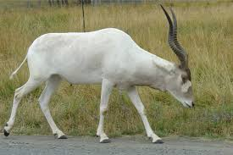
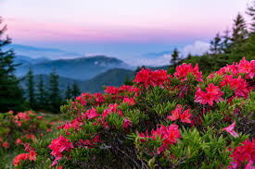
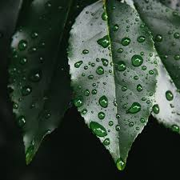
Water is the basic of all life. Every animal and plant contains water in its body. Water is essential for its body. Moisture in the soil is equally important for the life and growth of plants and trees.

Slide 11
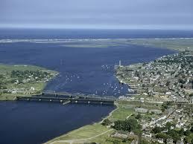
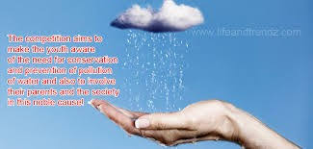
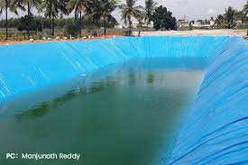
The conservation and utilization of water is fundamental for human welfare. At present streams and rivers wastefully empty themselves into the sea. It is clear that the adoption of techniques preventing soil erosion would help to conserve and keep the water where it is wanted.

Slide 12
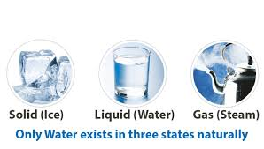

Hence Raman concludes by saying that though water is the commonest of liquids because of its easy availability, it is the most uncommon of liquids because it has the unique power of maintaining animal and plant life.

Slide 13


